Slide 1
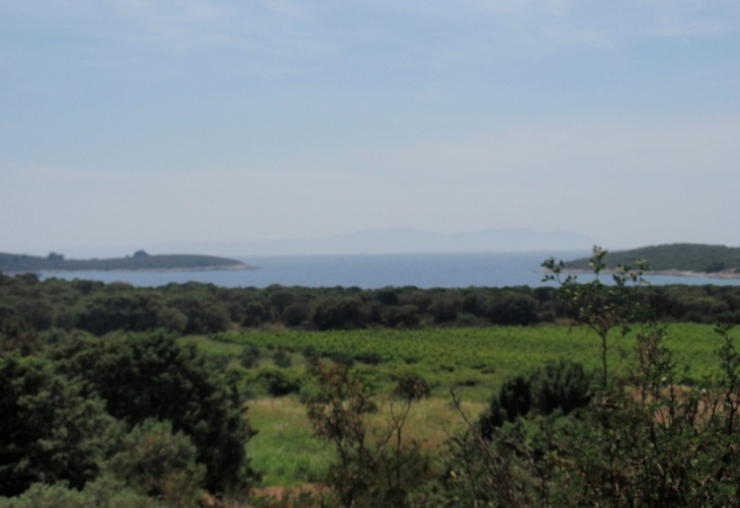
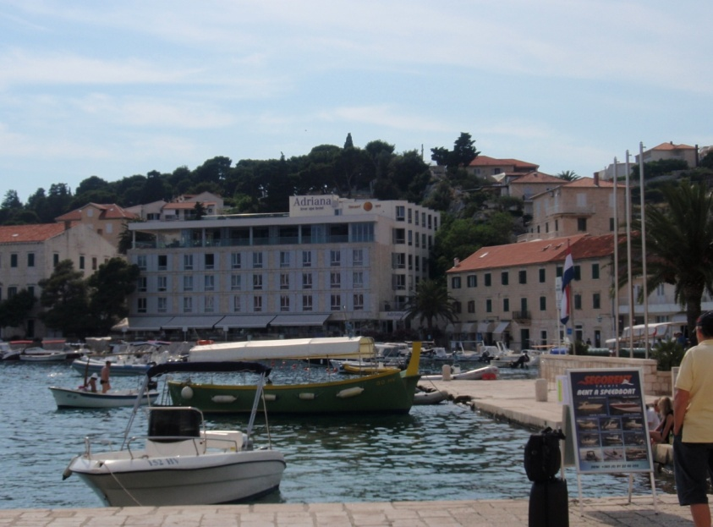


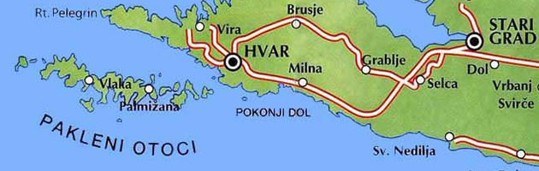
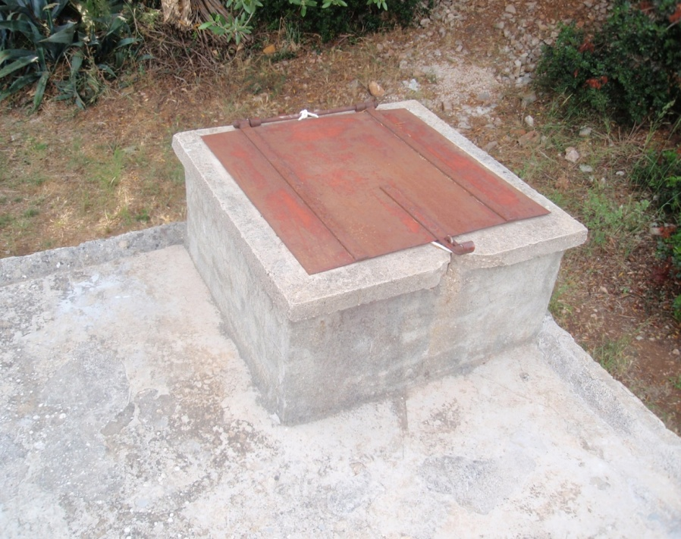
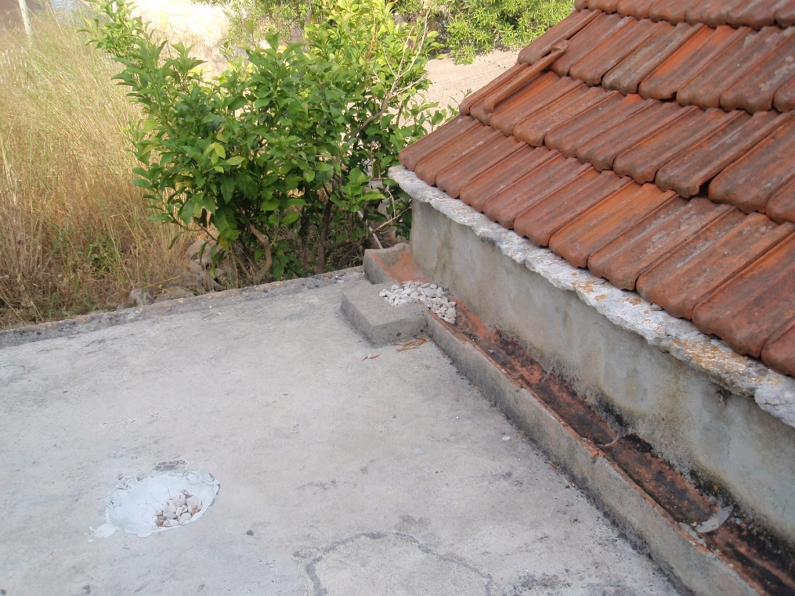

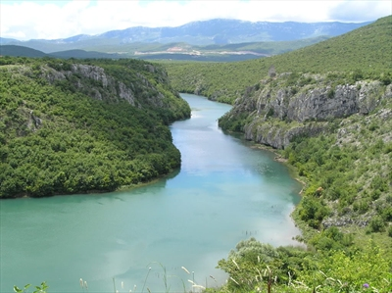
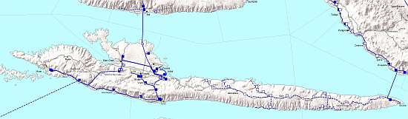
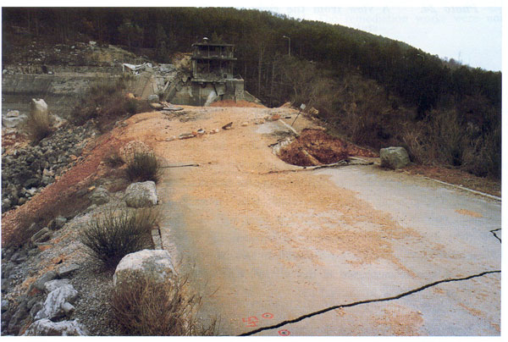
Sv. Klement
Historical Perspective of the Water Use Practices in an Arid Mediterranean Habitat – Islands of Hvar and St. Clement
Hvar
Channing James Faculty Advisors: Dr. Dalma Martinovic-Weigelt and Dr. Ivancica Schrunk
University of St. Thomas, St. Paul, MN
Abstract
Sample Analysis
Samples were analyzed using Enzyme Linked Immuno Assay (ELISA) for estradiol (E2) (Cayman Chemicals, Ann Arbor, Michigan).
The coast of Croatia and its nearby islands maintain an arid climate. These areas receive an average annual rainfall of 816 mm and a summer temperature ranging between 25°C and 35°C. They include few freshwater sources. The island of Hvar is one of the most arid and inhabited islands in Dalmatia. It is quite small (114 square miles) and not heavily populated (11,500 residents). St. Clement (Sv. Klement) Island is even smaller (2.0 square miles) and far less populated, with only one person living there throughout the year and varying amounts of others visiting in warmer months. Through personal interviews and research, it was found that in the past people living on both Hvar Island and St. Clement collected rainwater via cisterns usually located outside of their own homes or natural springs that may have been near, a practice continued from ancient times. In 1986, the Brač pipeline was built. It transports freshwater from the mainland river Cetina to the southern regions of Croatia and the islands of Brač, Šolta, and Hvar. Water practices have changed considerably, with the biggest change being that water is not treated as a limited resource. This new attitude, combined with increased tourism (ca 170,000 tourists visit Hvar island during summer months; the average stay is 5 days per individual) resulted in increased water use, and thus increased waste water flows into the sea (there is no wastewater treatment plant on the island). The question that this project focused on was whether the estrogens were present in the drinking water samples (modern vs. traditionally generated), and range of aquatic environments. This question was addressed through the analyses of a variety of drinking water, spring water, and seawater samples to assess the estrogenic activity (estradiol concentrations) in each, as estradiol is a good indicator of estrogenic pollution.
History of St. Clement
St. Clement, or Sv. Klement, is the largest of the small islands, called the Pakleni Otoci, located off the southwestern coast of Hvar. St. Clement was home to first Greeks and then Romans. Remains of a Roman villa can still be seen on the southern part of the island. Remains of saltworks are now under the water of Soline Bay. During Roman times, the small island was a very popular place to stop for drinking water (found in a spring), as the island’s location between two neighboring islands leads to relatively calm waters on the beaches. In the past 2000 years, the sea level has risen 2 meters, mixing any fresh water that was on the island with sea water. The Brač pipeline does not reach this island. Residents still rely on the use of cisterns to collect rainwater to be used for drinking, cooking, and cleaning.
Sv. Klement
http://hvar-express.com/eng/activities_hvar_pakleni.html
Results of water analyses
Detection limit of the method was 6.6 ng/L
All tested samples had detectable levels of estrogen.
The quantities of estrogen were below quantification method of the assay and as such were not quantified.
Traditional Rainwater Collection Methods
Discussion
St. Clement and Hvar were once both home to Greek and then Roman settlements. During those times, and up to 1986 cisterns were used to collect rainwater as these dry areas receive little rainfall.
In 1986, the Brač pipeline was built. It transports freshwater from the mainland river Cetina to the southern regions of Croatia and the islands of Brač, Šolta, and Hvar. Since the pipeline has begun delivering water to these areas, tourism increased, and water practices have changed significantly. While cisterns are still needed/used on St. Clement , Hvar no longer uses them.
The waste water of St. Clement flows into septic tanks, while the waste water of Hvar runs directly into the sea.
ELISA-based analyses of the water samples taken from various areas of Hvar, Split, and St. Clement found that samples had detectable levels of estradiol, but that these levels are quite low, and probably of no biological significance, as biological effects of estrogens below this concentrations are negligible.
However, because estradiol is frequently found in the mixture with other estrogens, and these may have additive effects, the studies of total estrogenic activity should be conducted.
We plan to conduct further water analyses by using an in vitro reporter gene assay that assesses total estrogenic activity by evaluating binding to, and activation of the estrogen receptor.
Well of Abandoned Home (St. Clement) Cistern
Abandoned Home Gutters
and Well of Cistern
(UNEP, 1997)
Objectives
New Water Source – Inland River (Cetina)
Research water supply/use practices in arid Adriatic environment.
Determine whether estrogens are present in the drinking water, and coastal aquatic environments.
Methods
Water Sample Collection
10 separate water samples, of 25mL were collected
Samples in water from
1. The Pansion Cistern (St. Clement)
2. Nikola Colnago’s Cistern (St. Clement)
3. Soline Bay (St. Clement)
4. Tonko Matijević’s Cistern (St. Clement)
5. Spring Water (St. Clement)
6. Spring Water (St. Clement)
7. Tap Water of Restaurant on Hvar
8. Water seeped into archaeological trench 4 (St. Clement)
9. Paradiso Hotel (St. Clement)
10. Tap water from home in Split, Croatia
^{Brac pipeline}
In 1986, the Brač pipeline was built. It transports freshwater from the mainland river Cetina to the southern regions of Croatia and the islands of Brač, Šolta, and Hvar.
Drinking Water Security and War
The Peruća lake is one of the largest reservoirs in the Cetina Hydropower System. The Peruća lake reservoir active storage is about 37% of the mean annual inflow, and it considerably affects the Cetina flow regulation.
On January 28, 1993, the dam was blown up in an intentional effort to destroy it by Serbian/Yugoslav army forces. Water supply was temporarily disrupted.
References
Rainwater from Rooftop Catchments. Unit of Sustainable Development and Environment General Secretariat, Organization of American States Washington, D.C., 1997. Source Book of Alternative Technologies for Freshwater Augmentation in Latin America and the Caribbean. Available from: <http://www.oas.org/DSD/publications/Unit/oea59e/ch10.htm>

